Slide 1
Recap SW2 Lars Gisler/ Cyrill Wyss
Project Structure/ VCS/ GIT

Slide 2
Content
Concepts
- Git/Github
- Conflicts
- Ignore-File
- Common Files in Projects
Questions
Demonstration of Conflict Solving Process

Slide 3
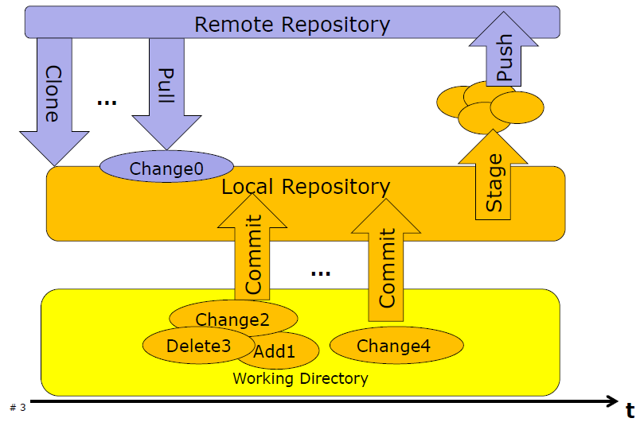
Git

Slide 4
Github
Remote Repository for Version Control
Everything is public (for free)
Private with owner control access (NOT for free)
Client needed on Computer (SourceTree)

Slide 5
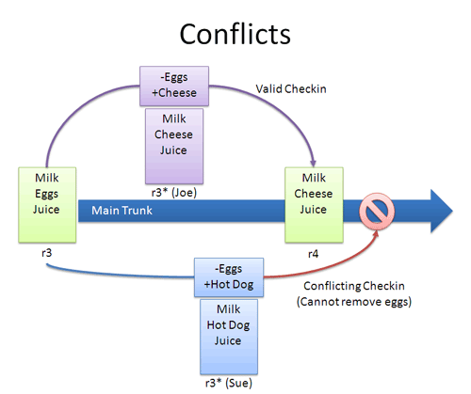

Slide 6
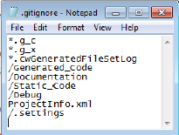
.gitignore - File
Define files and folders which shall not be pushed and pulled to/from the remote repository
We share everything which is needed to build the project
(.project, .cproject, *.c, *.h, *.launch, Project_Settings,
Special rules for ProcessorExpert.pe needed!!! )

Slide 7
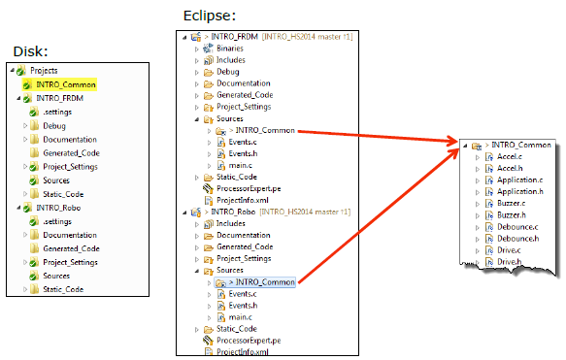
Common Folder with Links

Slide 8
Questions
Why do we need to ignore files?
Telling the VCS to not check in files
You don’t need to put all files in the repo. (Auto generated ones)
Saves space on the VCS
Reduces conflicts

Slide 9
Questions
Why ignoring folders in a repository is useful?
Same reasons as for files
No need to explicit ignore every file in folder

Slide 10
Questions
Why should you separate the Eclipse workspace from the projects?
You do not want to commit the workspace files
Workspace is unique to your machine

Slide 11
Questions
Why it can make sense to have multiple VCS clients installed (e.g. TortoiseGit and SourceTree)?
Different clients support different VCS
Different range of functionality

Slide 12
Questions
How can you create a conflict yourself?
Create two clones
Edit the same file in both clones (also check that you edit the same lines)
Commit on both clones
Push on both clones (the later push will create the conflict)

Slide 13
Questions
Do you need a server to use Git?
No. You can create a local repository

Slide 14
Questions
What is the difference between Clone and Pull?
Clone: clones an existing repo to your machine
Pull: pulls the content of a previous cloned repo

Slide 15
Questions
What is the difference between Stage and Push?
Stage: Select files to commit
Push: Push the committed files to the remote repository

Slide 16
Questions
Why do you need to add collaborators?
To give the collaborators access to your repo

Slide 17
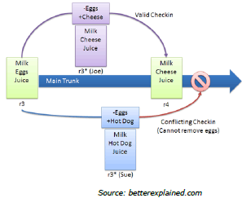
Conflict Solving Example

